Slide 1
Generative ai
Technical University of Kosice
Faculty of electrical engineering and informatics
Computer modelling

Slide 2
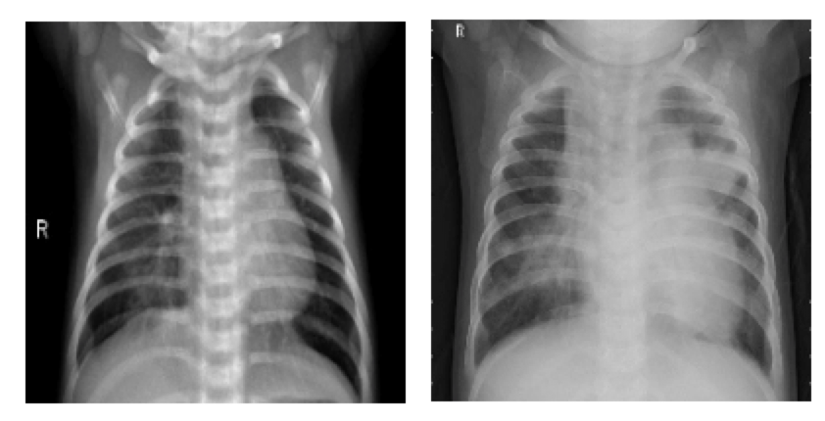

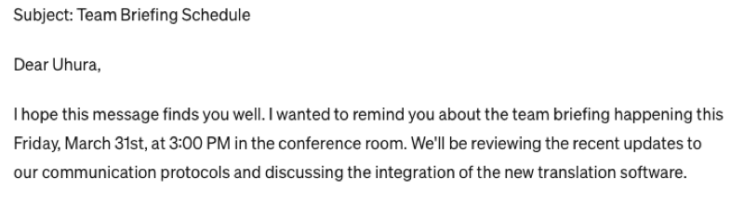
Discriminative models
Spam
Not spam
Healthy
Pneumonia

Slide 3
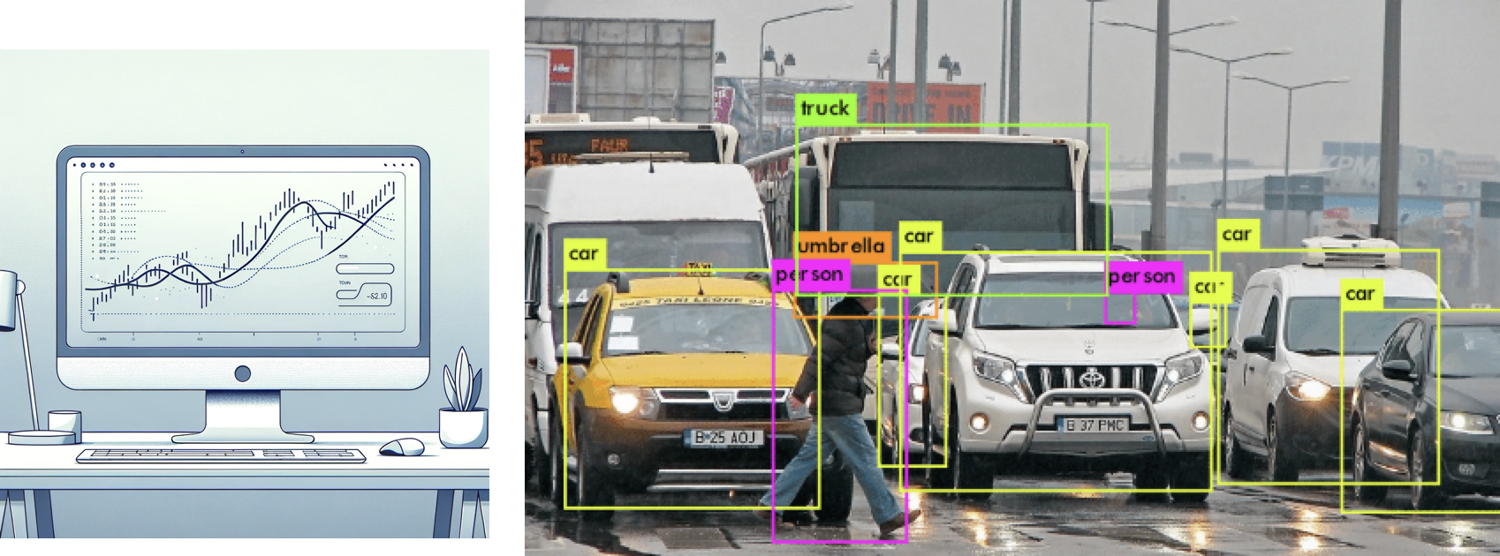
Discriminative ai
Predict energy prices
Detection

Slide 4
Autoencoder

Slide 5
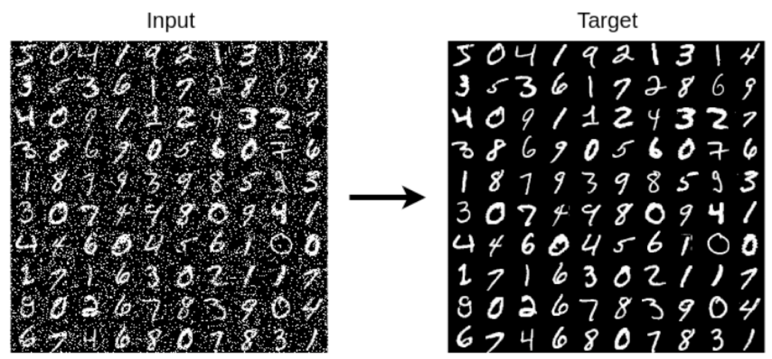

Slide 6
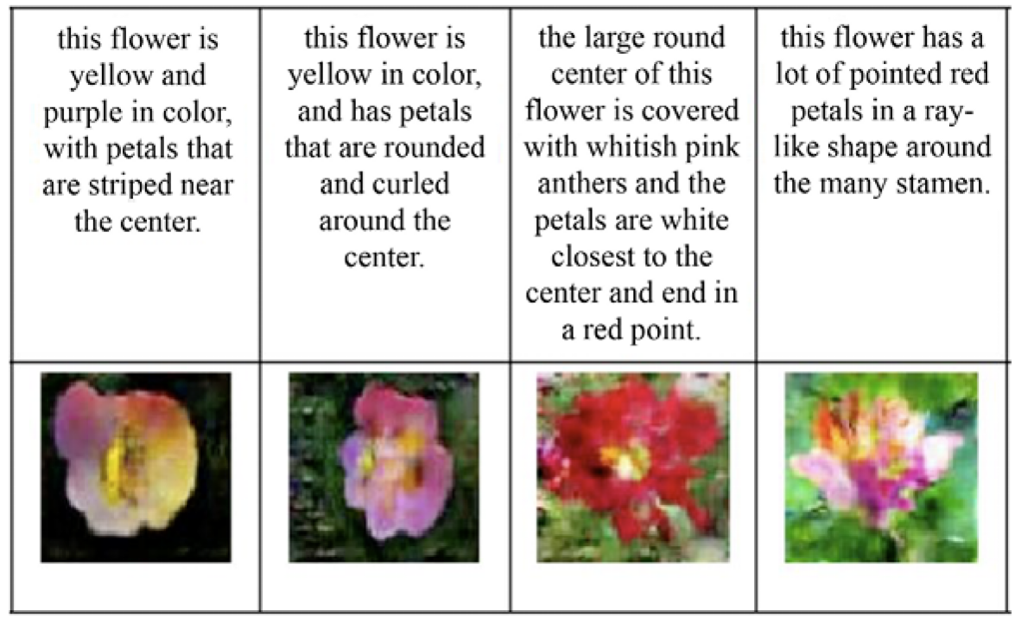
Generative ai

Slide 7
Generative models
Variational autoencoders (vae)
Generative adversarial networks (gans)
Stable diffusion (SD)

Slide 8
Statistical terms
Prior distribution p(z) – how common is the cause?
Likelihood p(x|z) – does the cause fit the data?
Joint distribution P(x, z) – how often do they happen together?
Marginal distribution p(x) – how common is the data?
Posterior distribution P(z|x) – what is the diagnosis?
X = fever
Z = flu

Slide 9
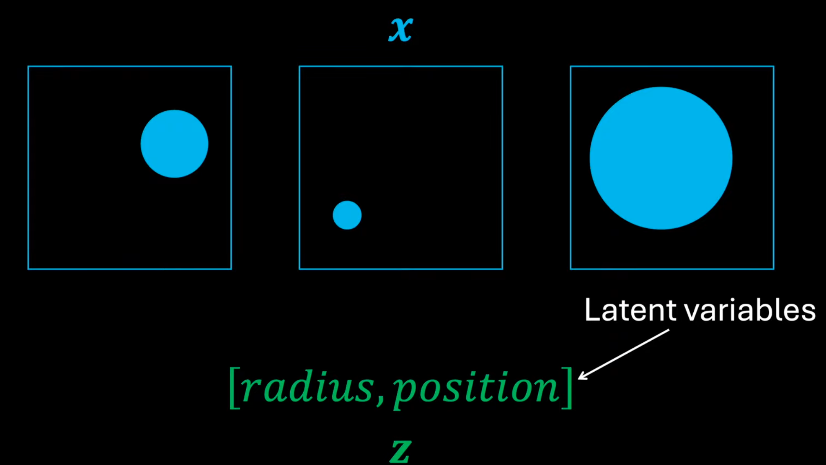

Slide 10
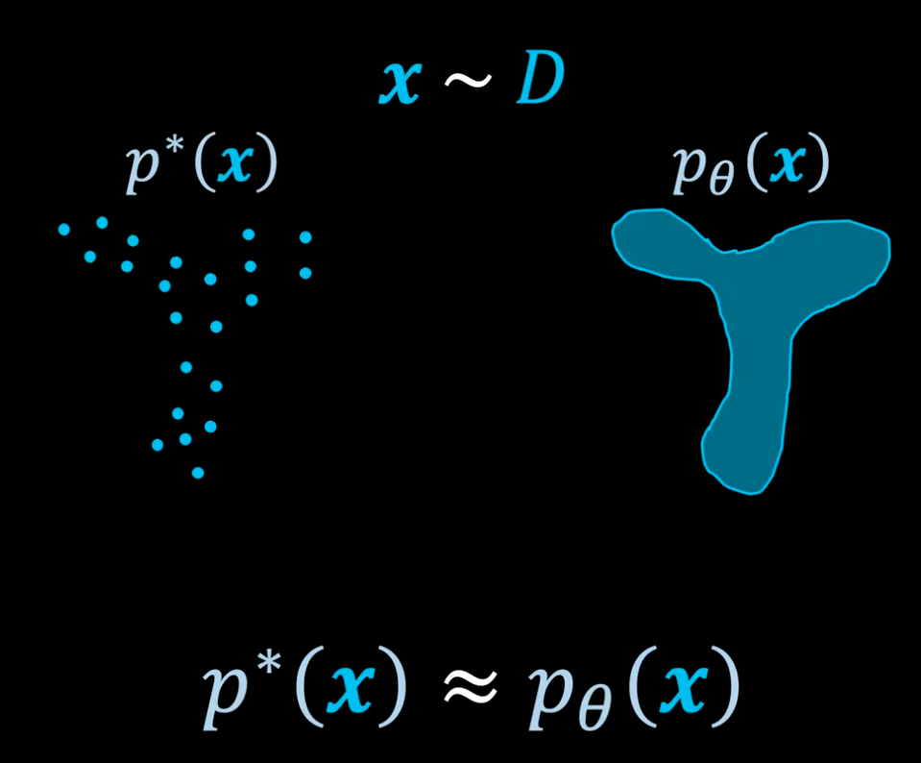

Slide 11
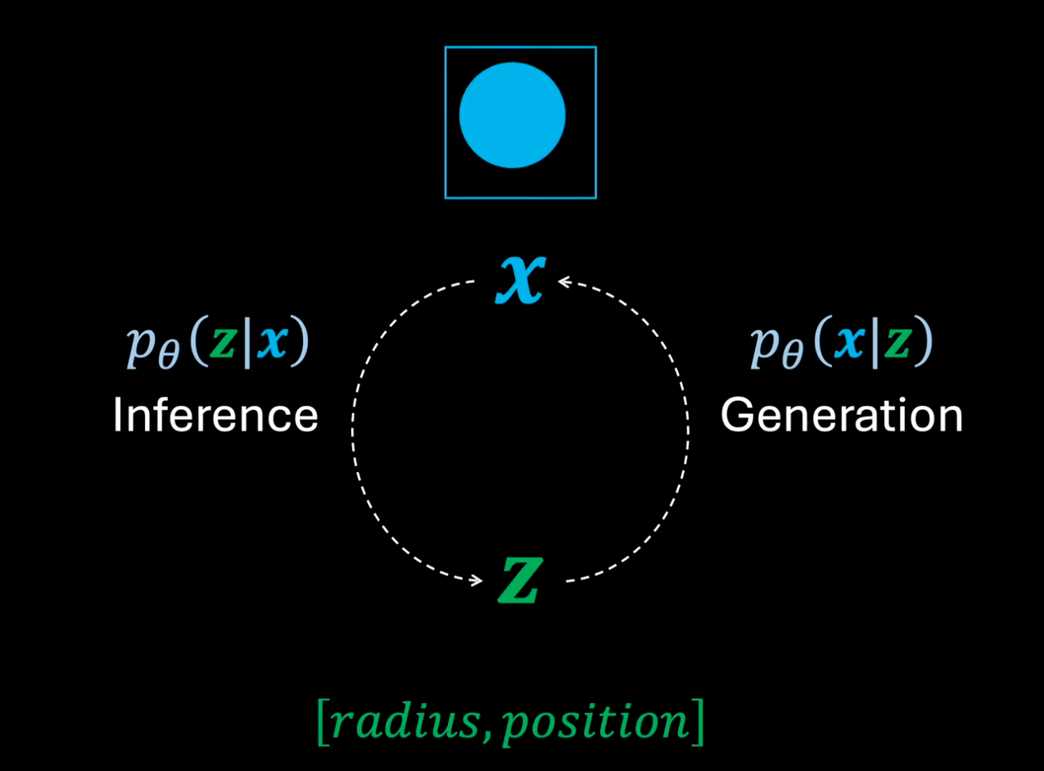

Slide 12
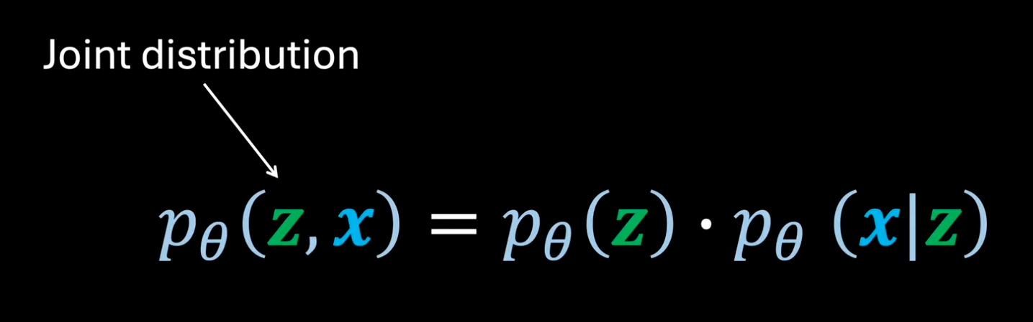

Slide 13
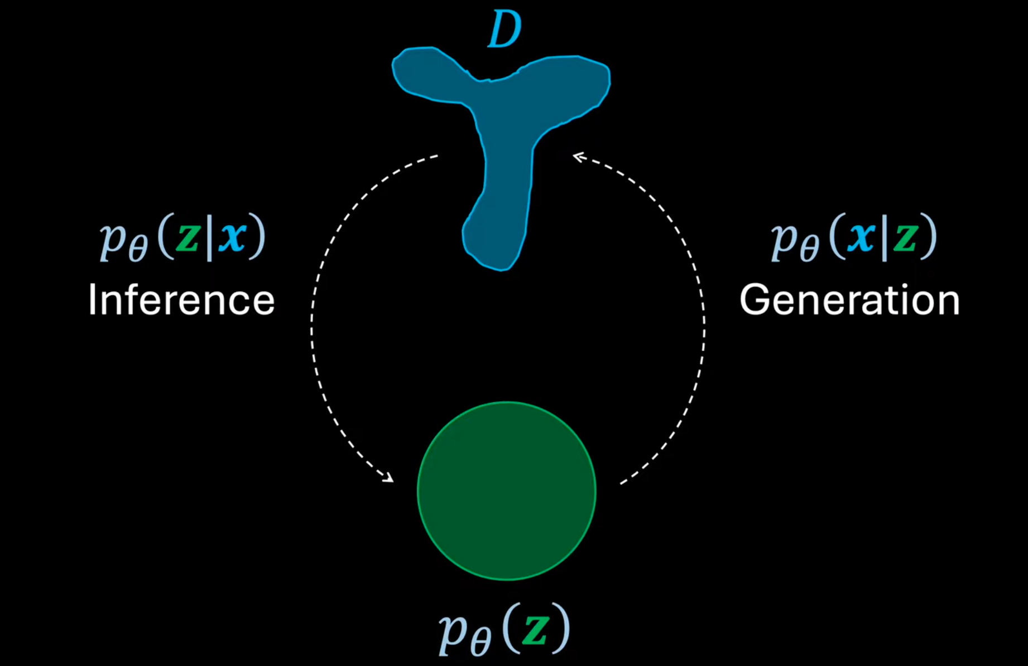

Slide 14
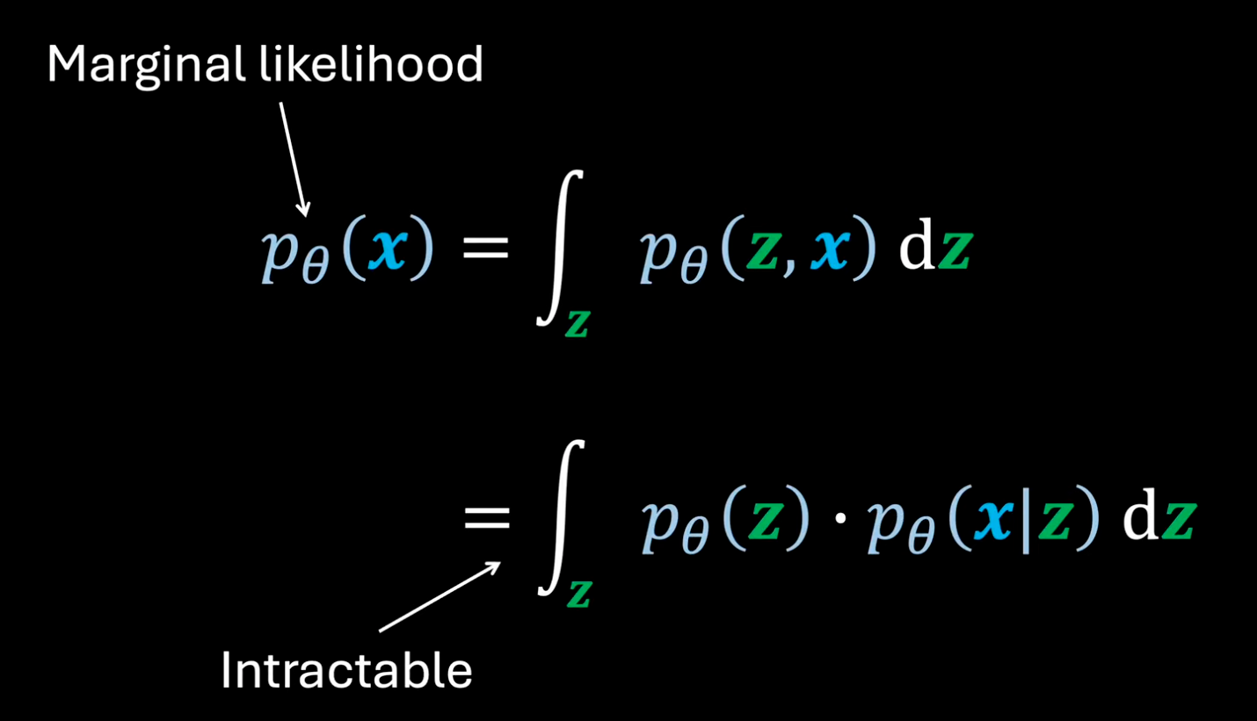

Slide 15
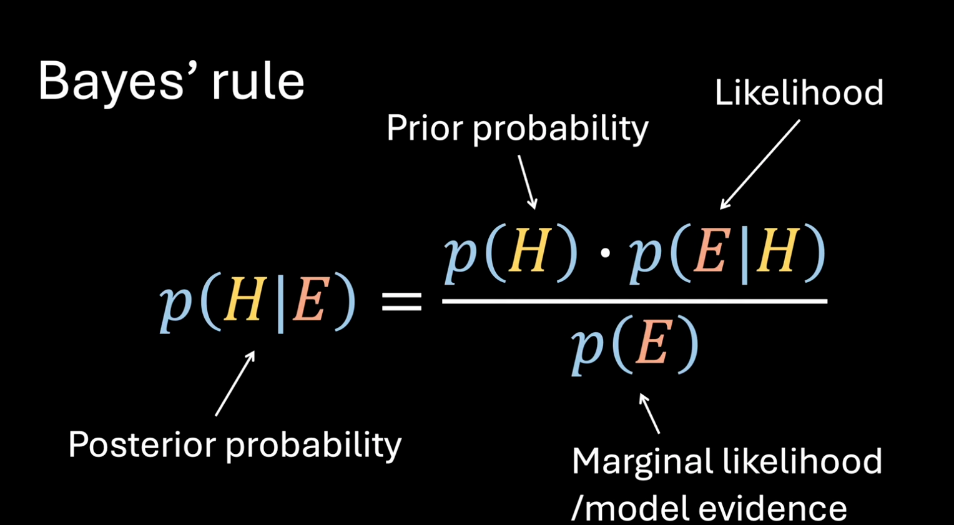

Slide 16
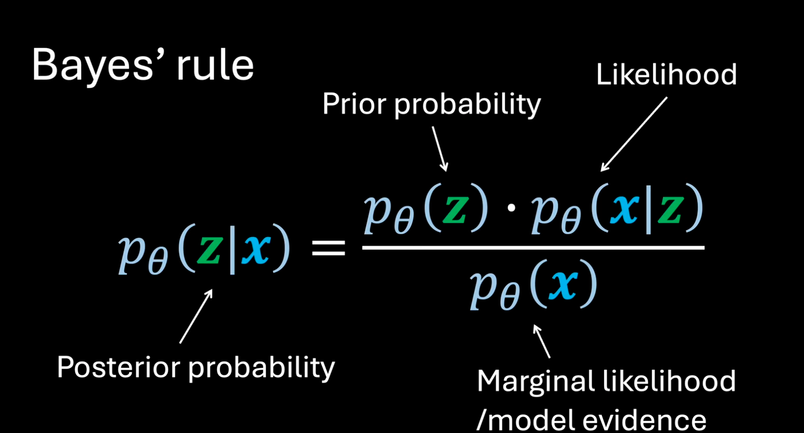

Slide 17
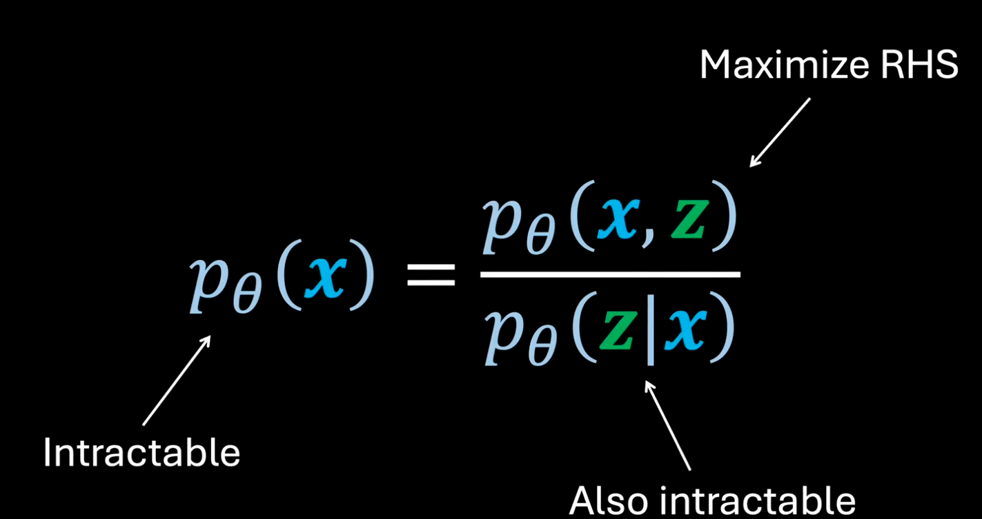

Slide 18
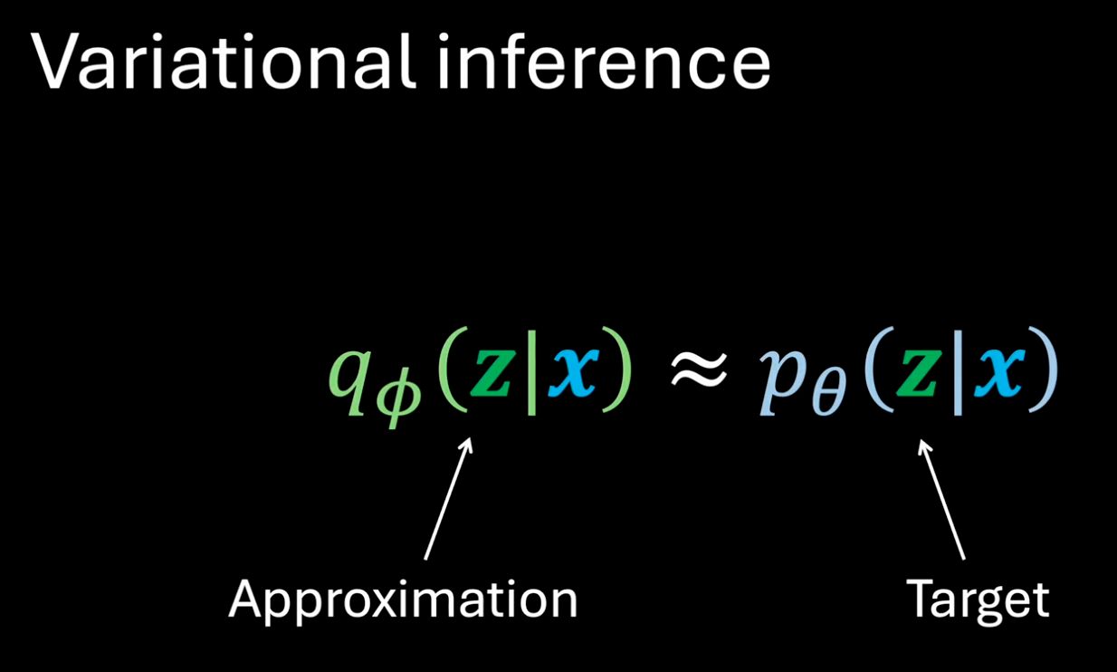

Slide 19
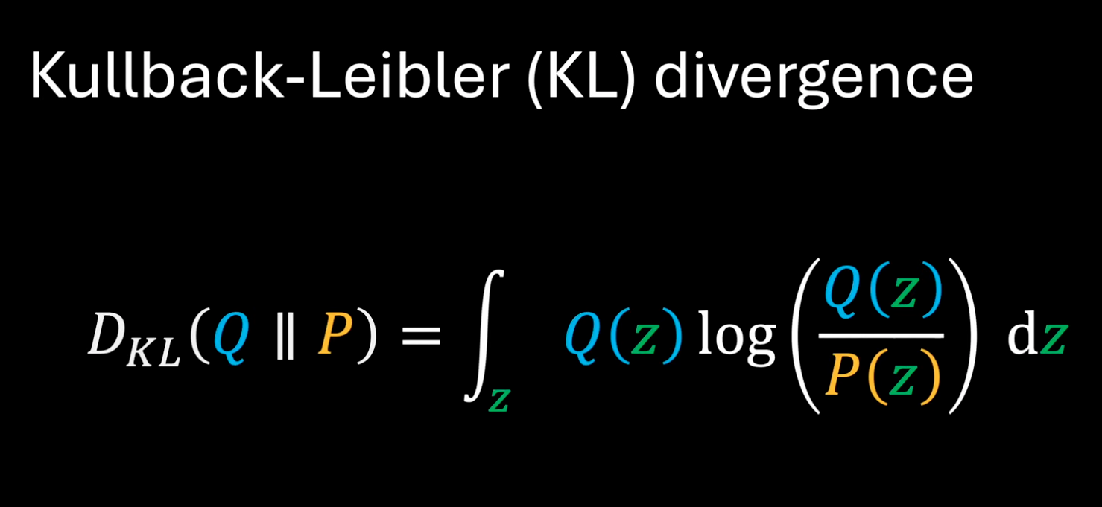

Slide 20
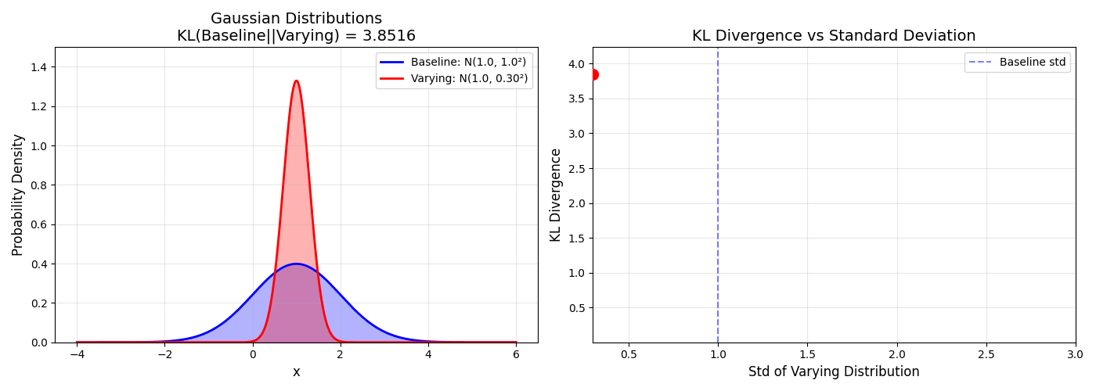
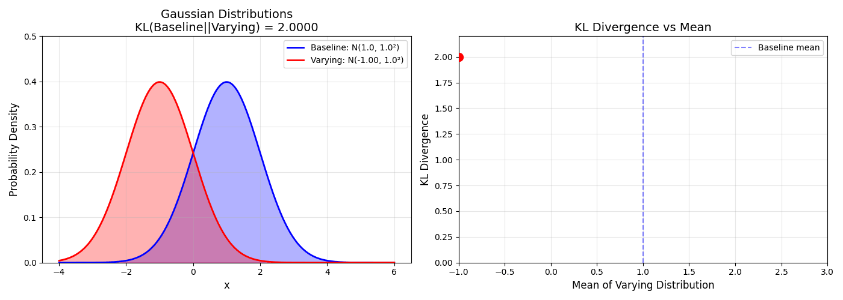

Slide 21
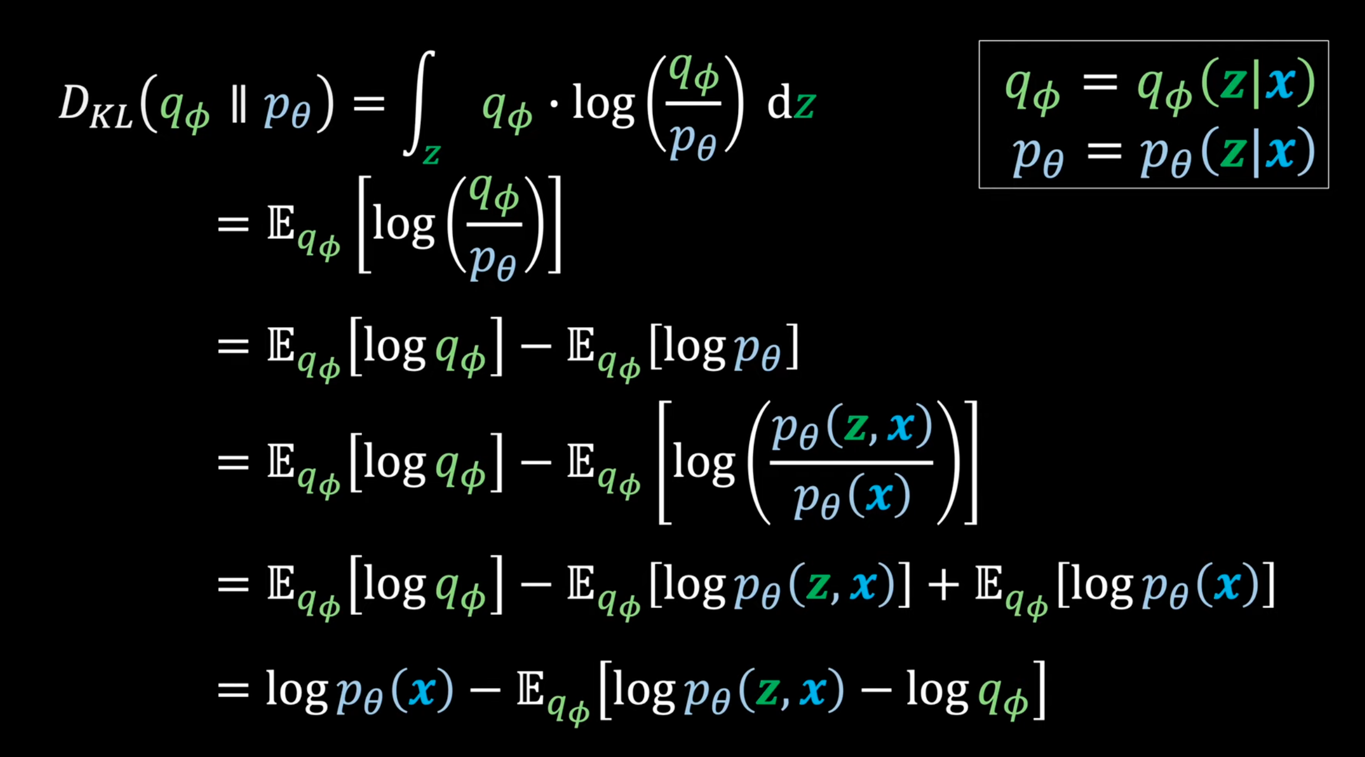

Slide 22
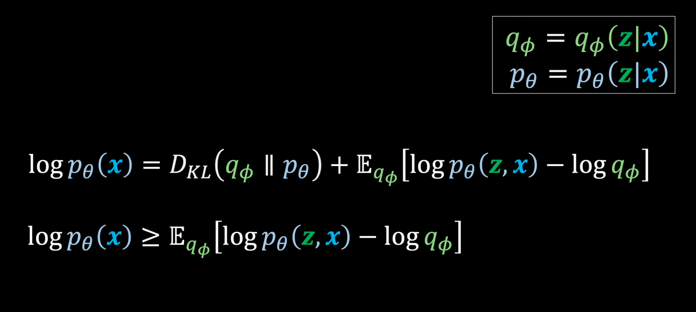

Slide 23
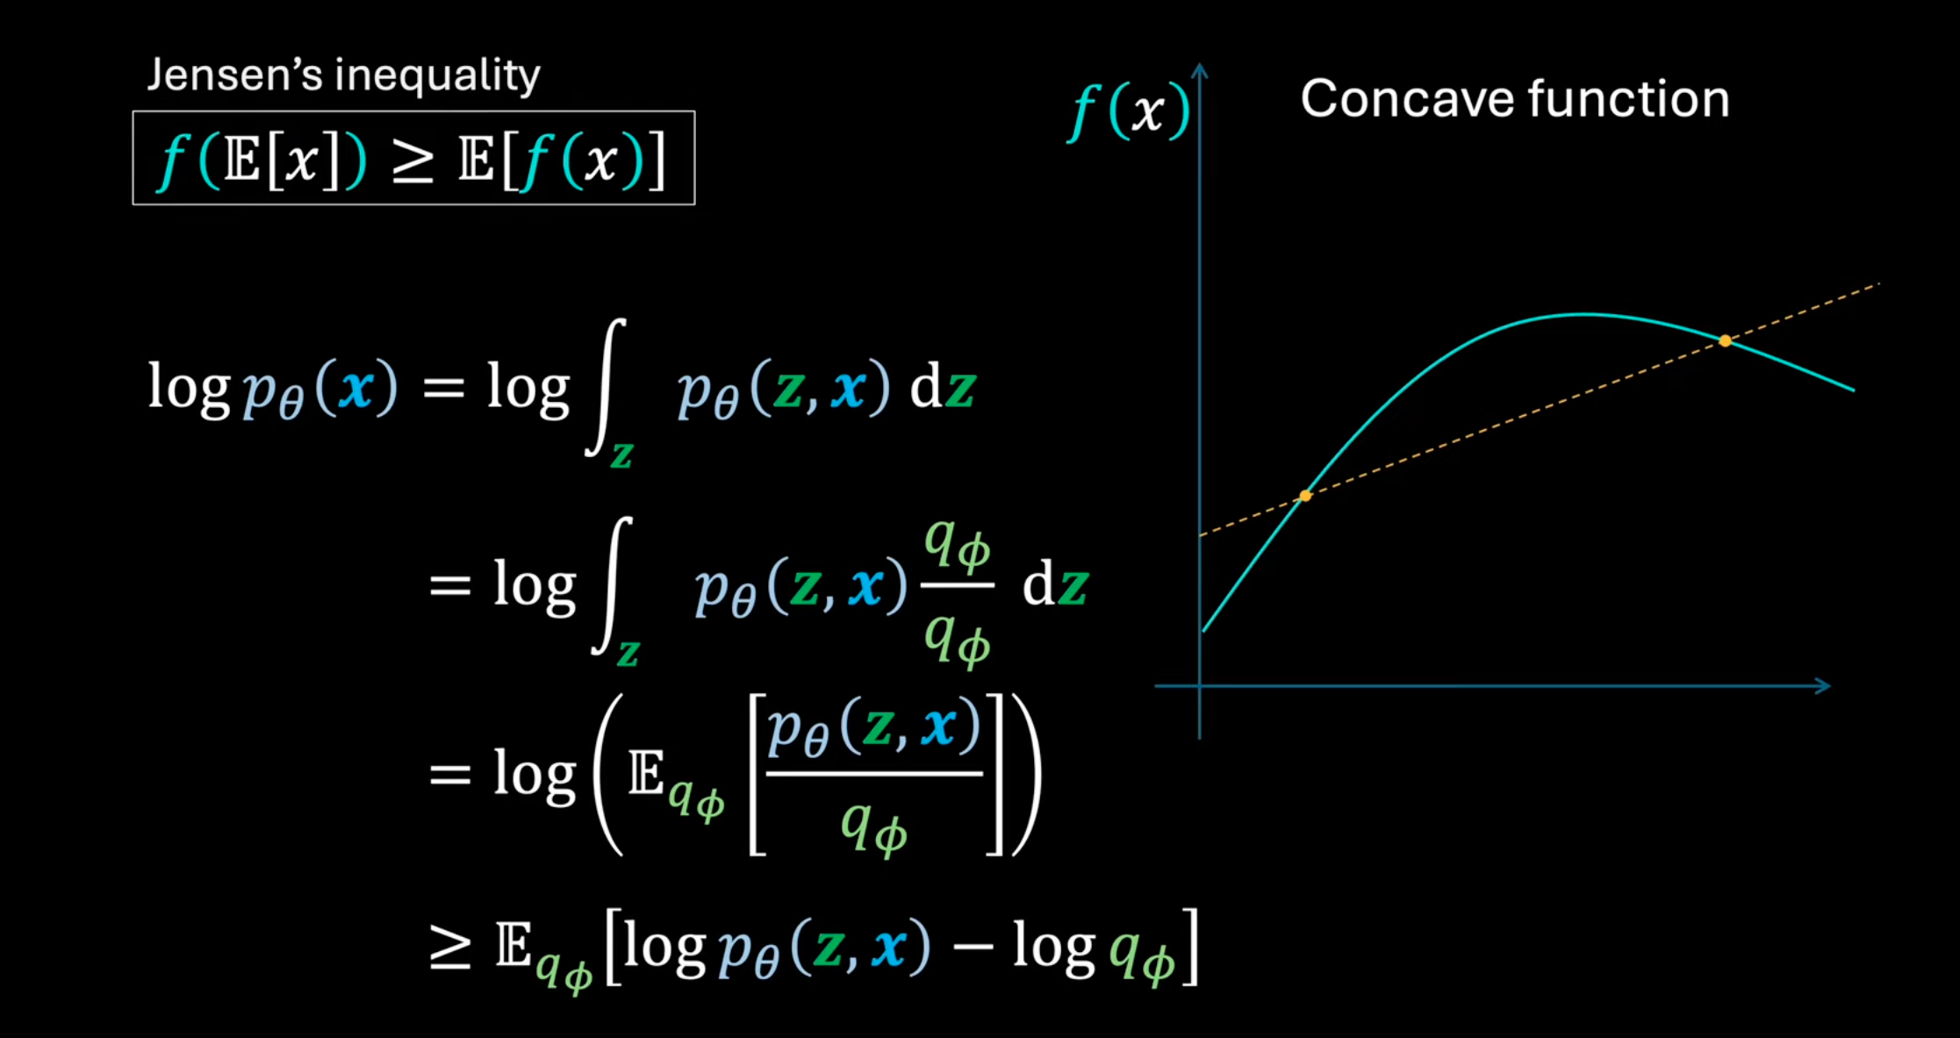

Slide 24
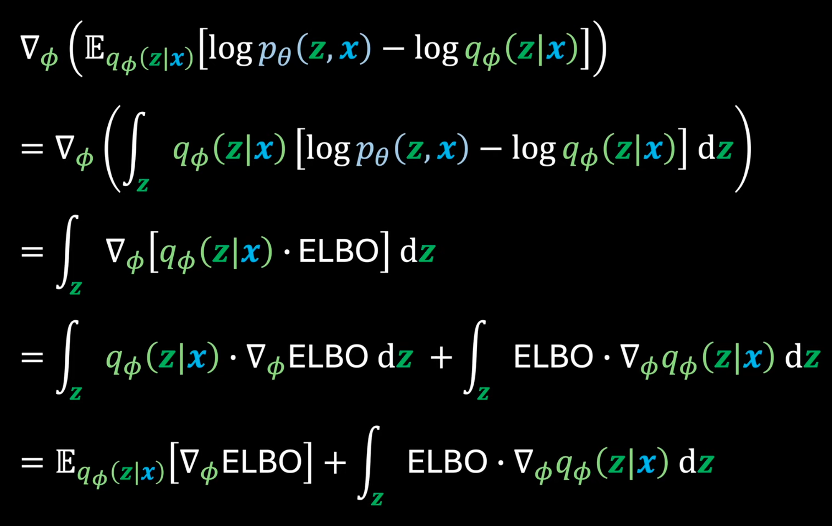

Slide 25
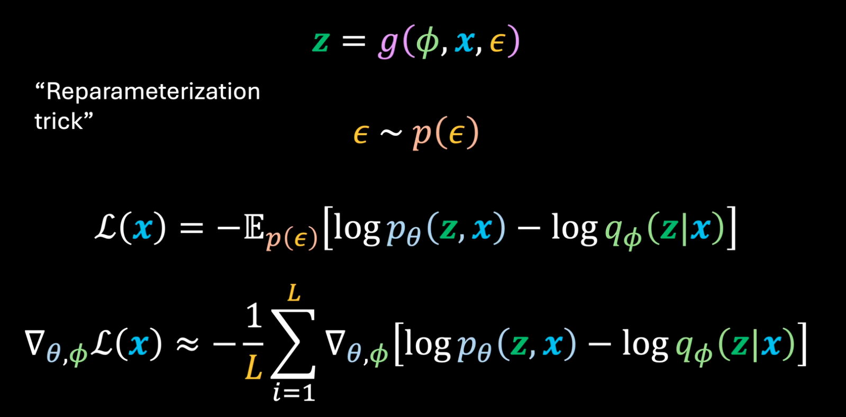

Slide 26
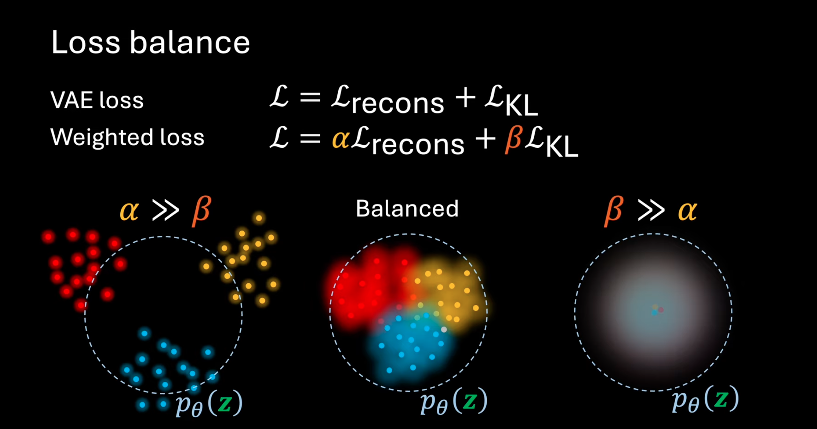

Slide 27
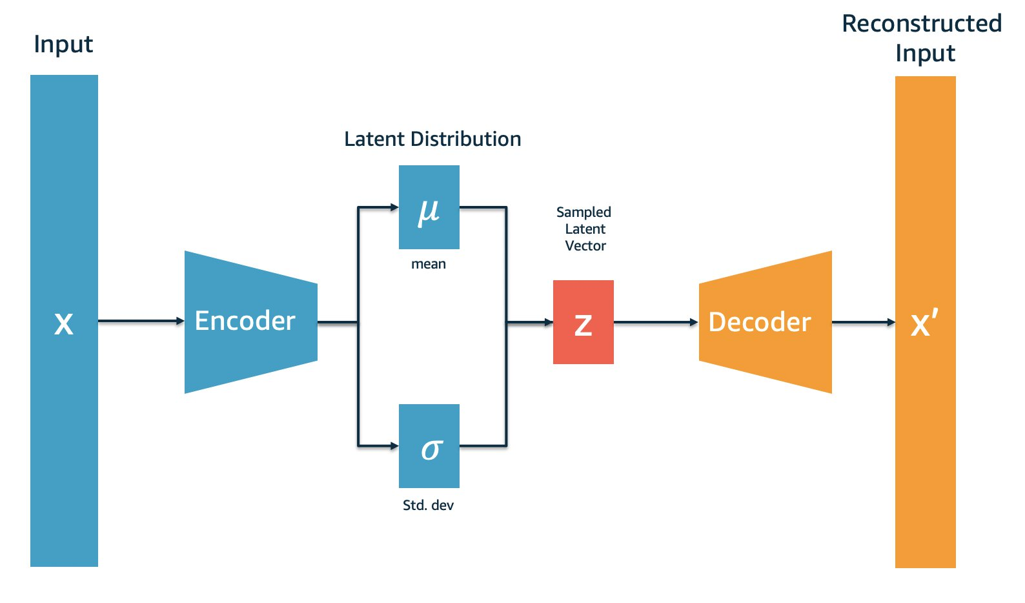
Variational Autoencoder

Slide 28
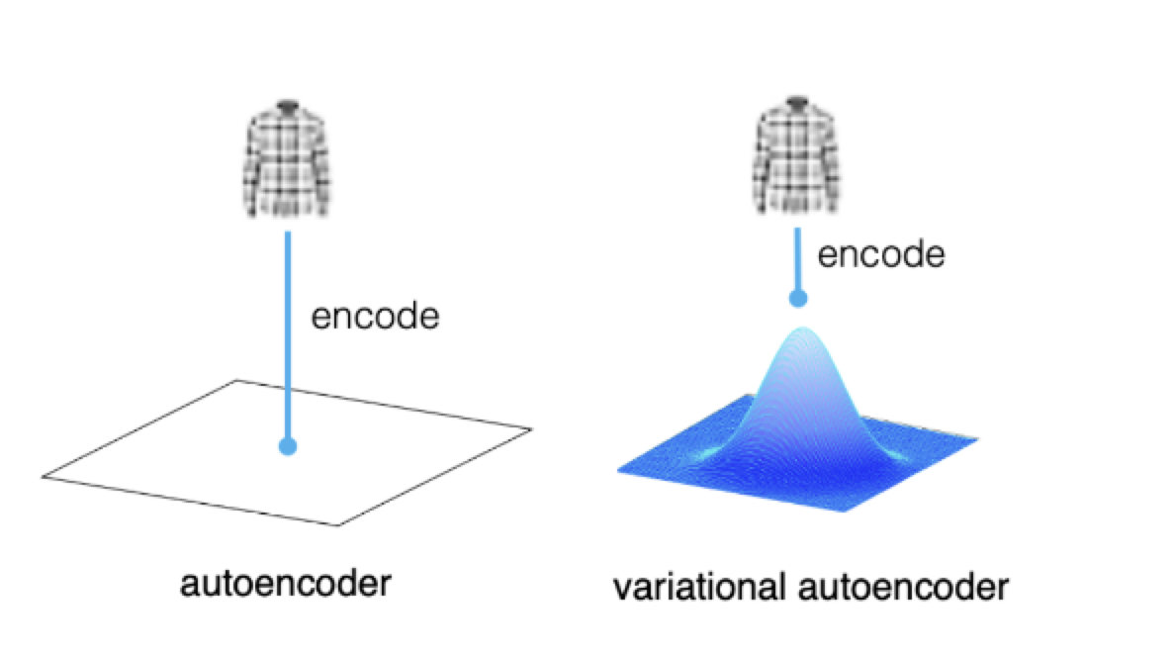
1 sample is in AE represented in the embedding space with 1 vector
1 sample is represented with probability distribution in latent space

Slide 29
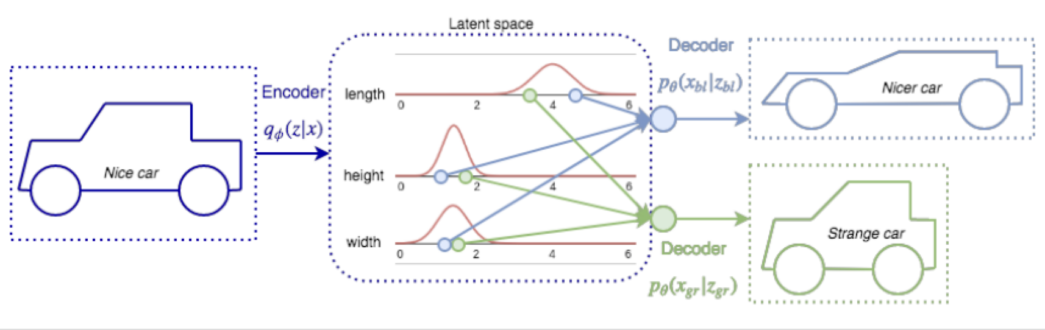

Slide 30
AE -> V(AE)
AE
AE + KL = VAE
reparametrization trick – not able to get derivative of gaussian

Slide 31
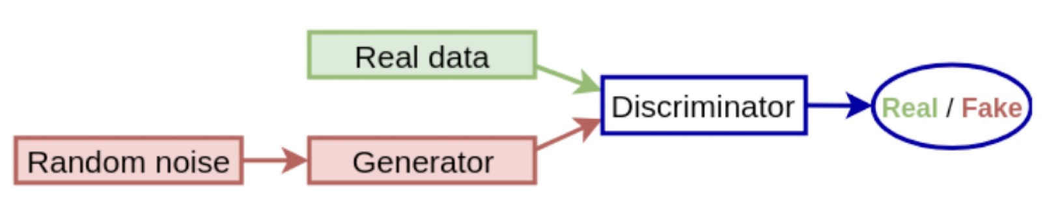
gans
A GAN is a framework where two neural networks contest with each other in a zero-sum game: the Generator aims to approximate the true data distribution to create realistic samples, while the Discriminator optimizes a binary classification to distinguish between real data and the generator's fake output.

Slide 32
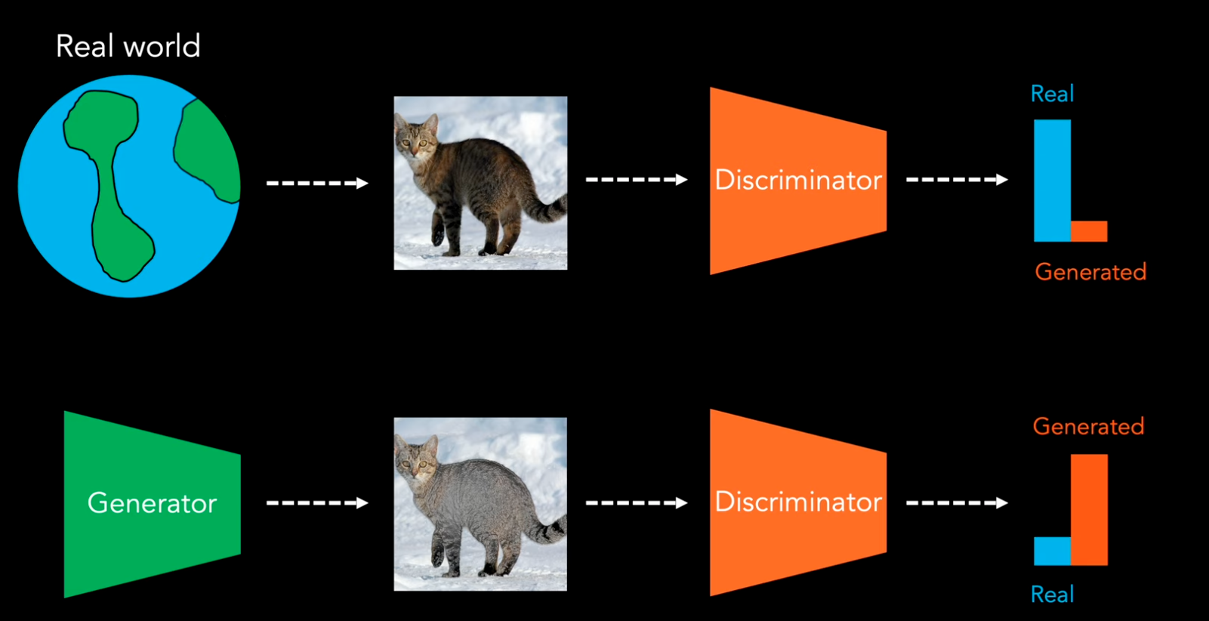

Slide 33


Slide 34
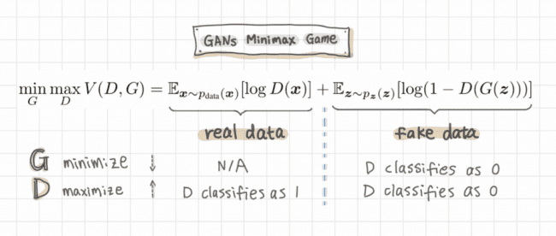
Minmax game

